Slide 1
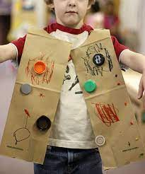
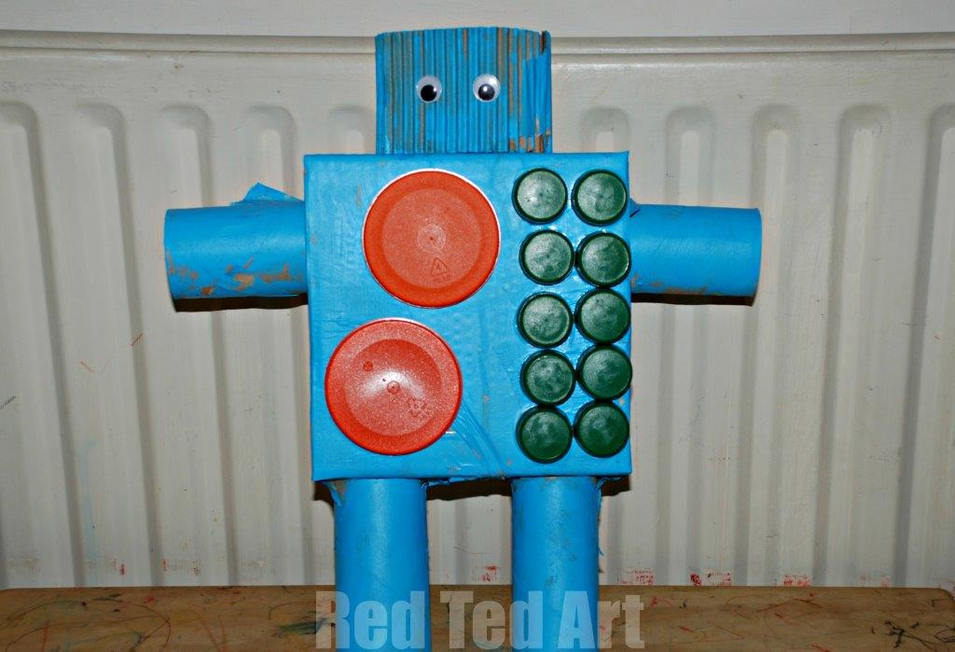
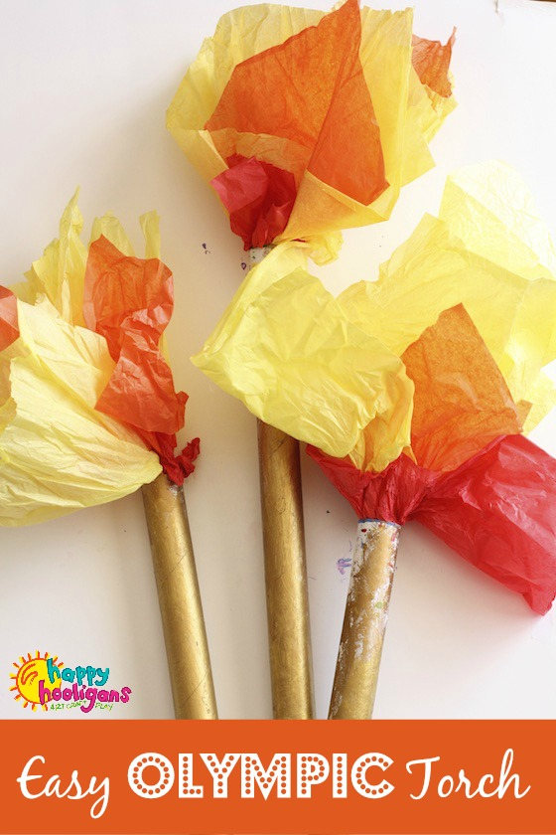
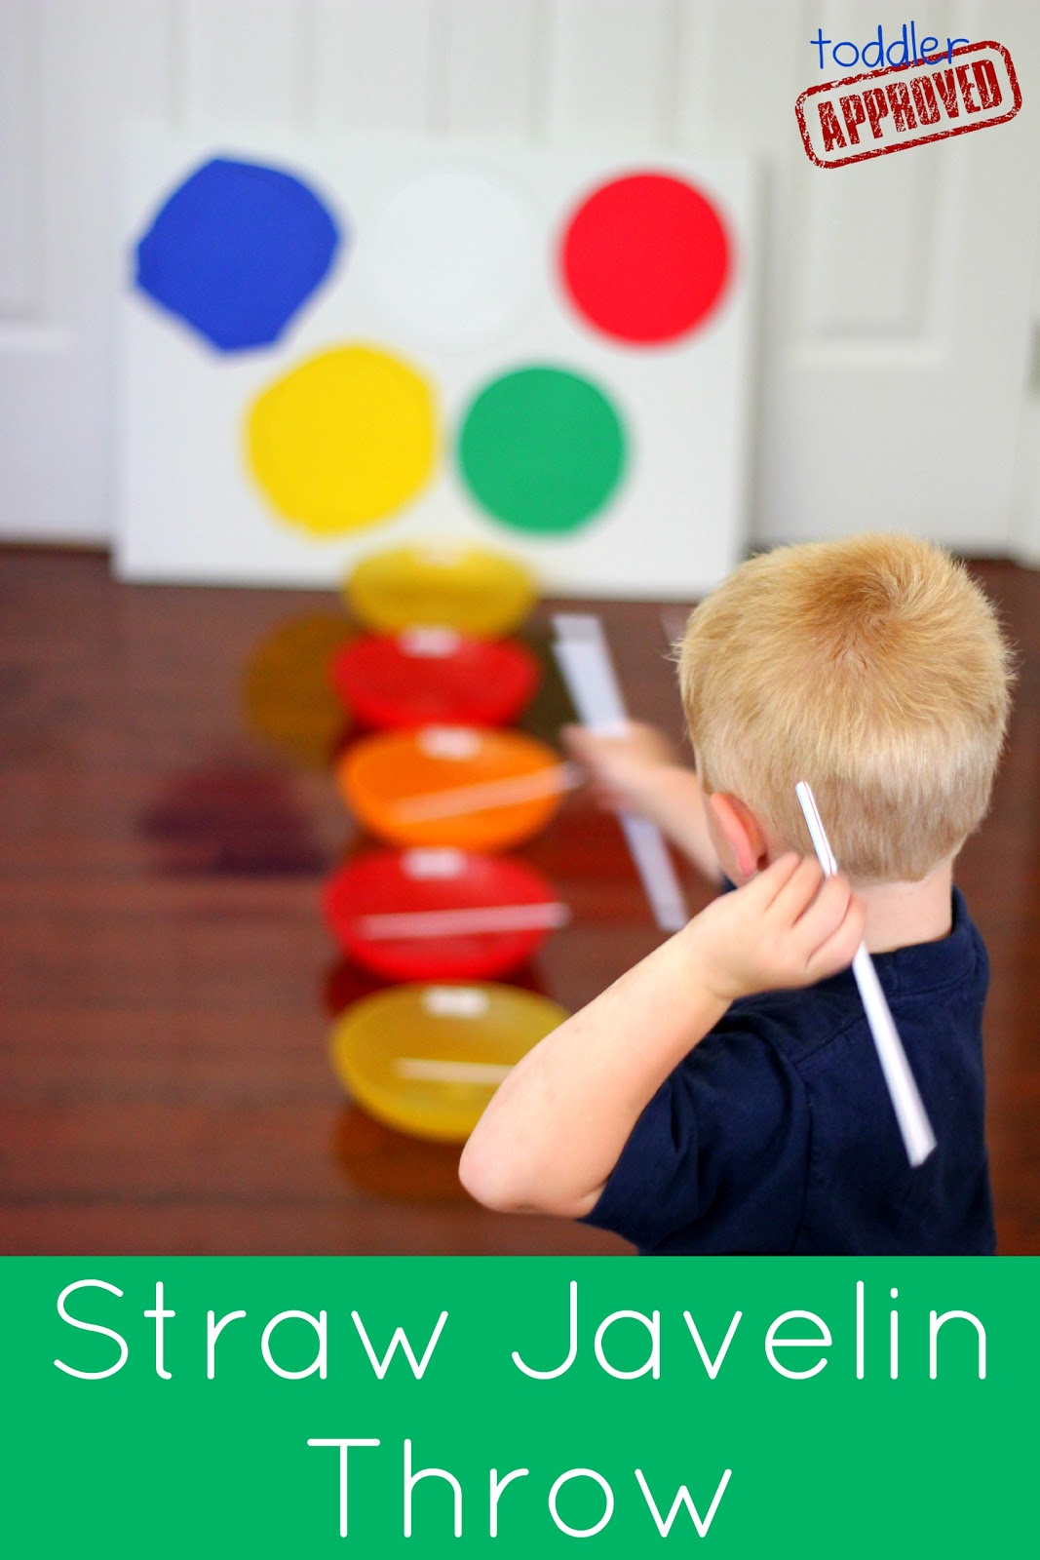
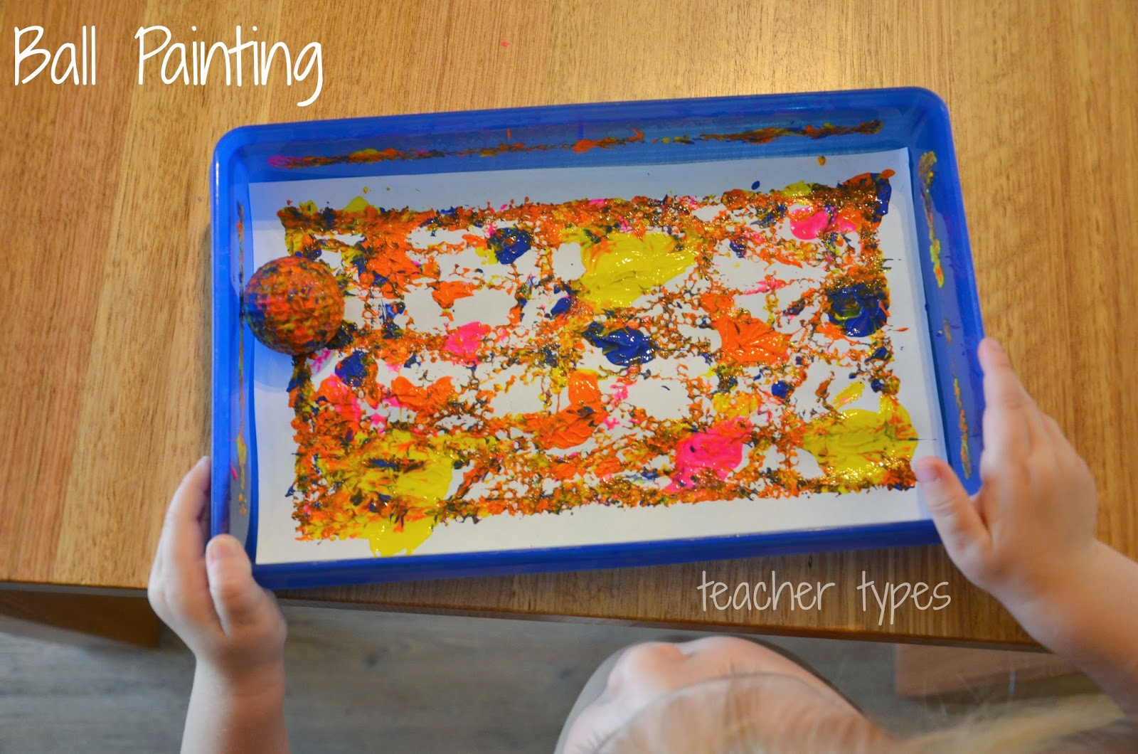
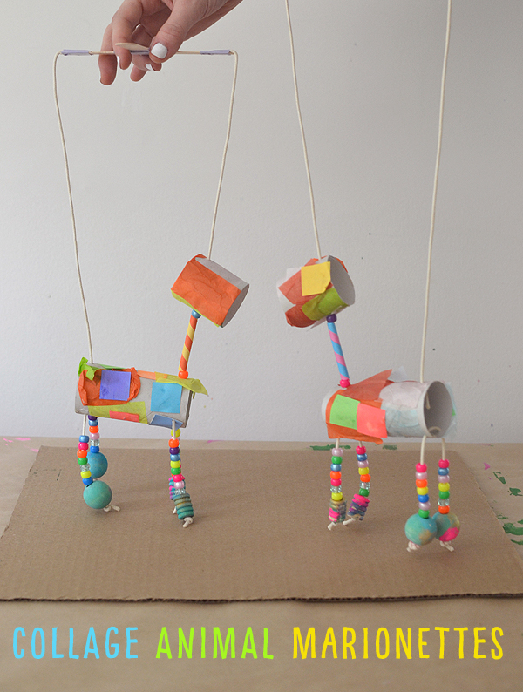
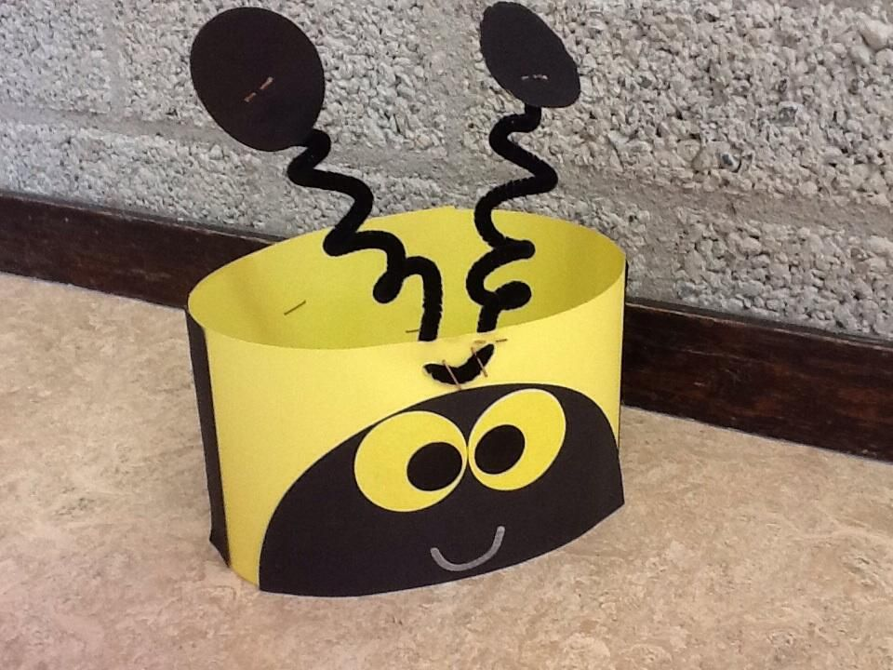
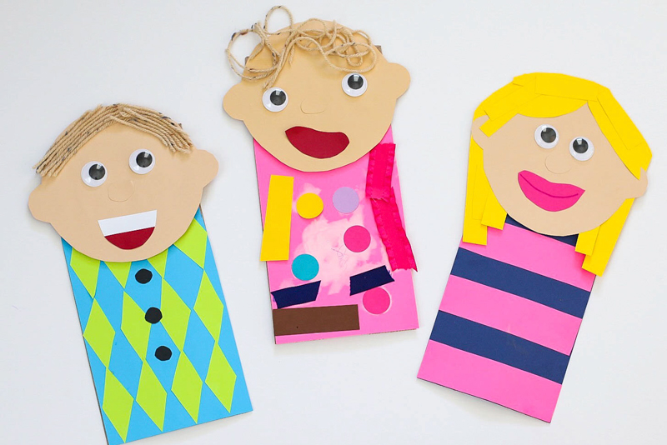
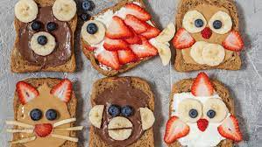
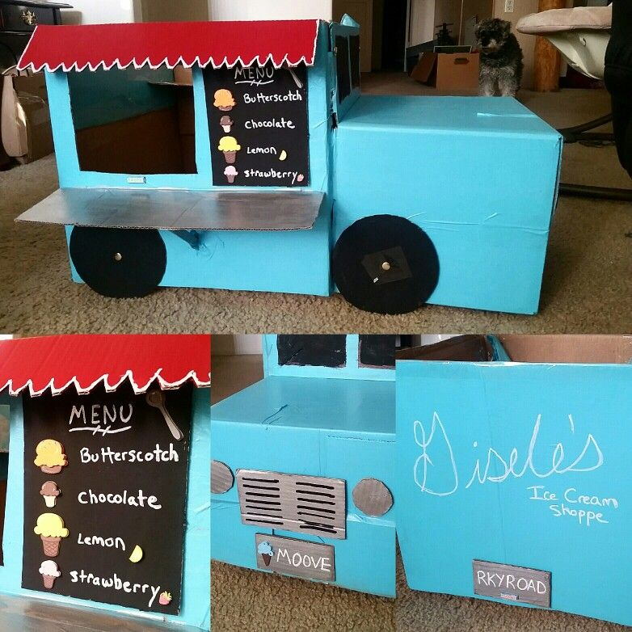
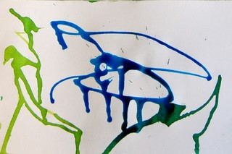
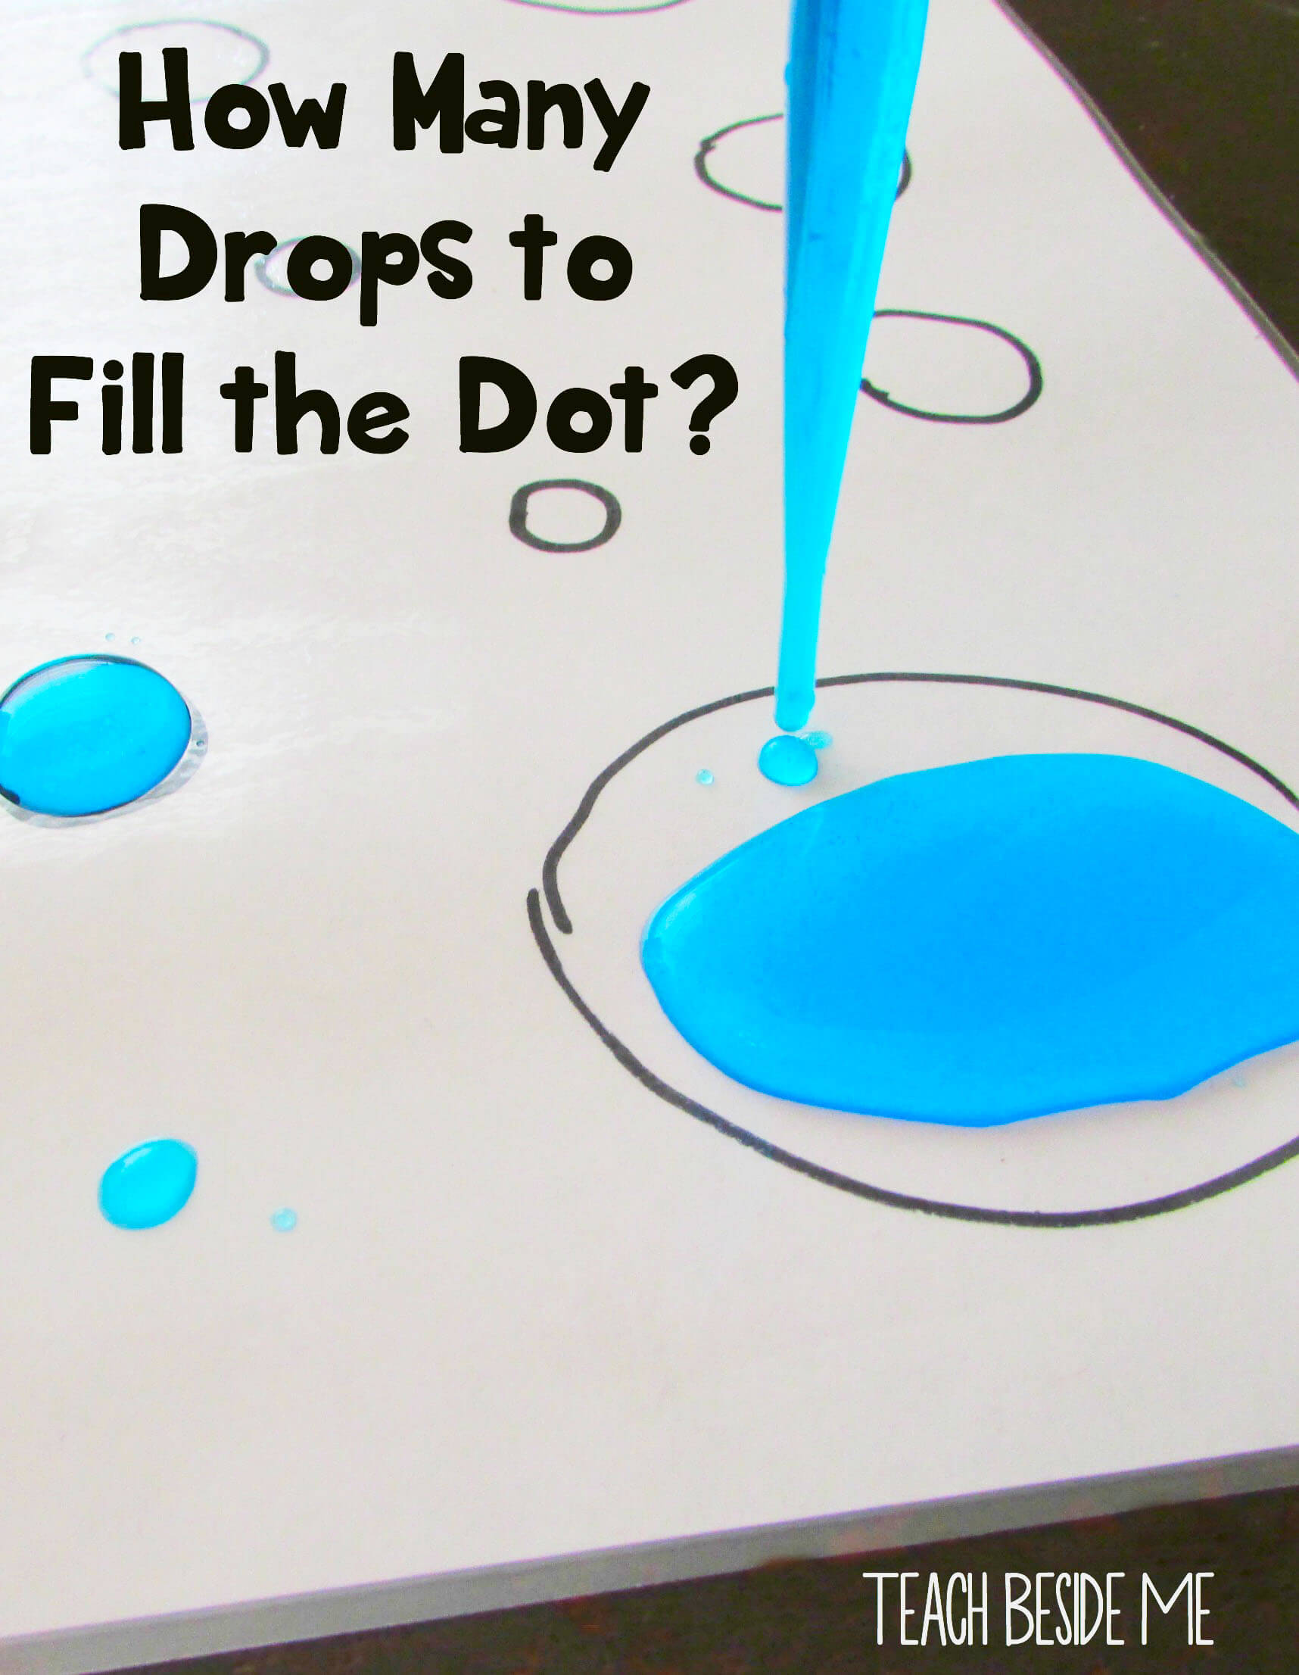
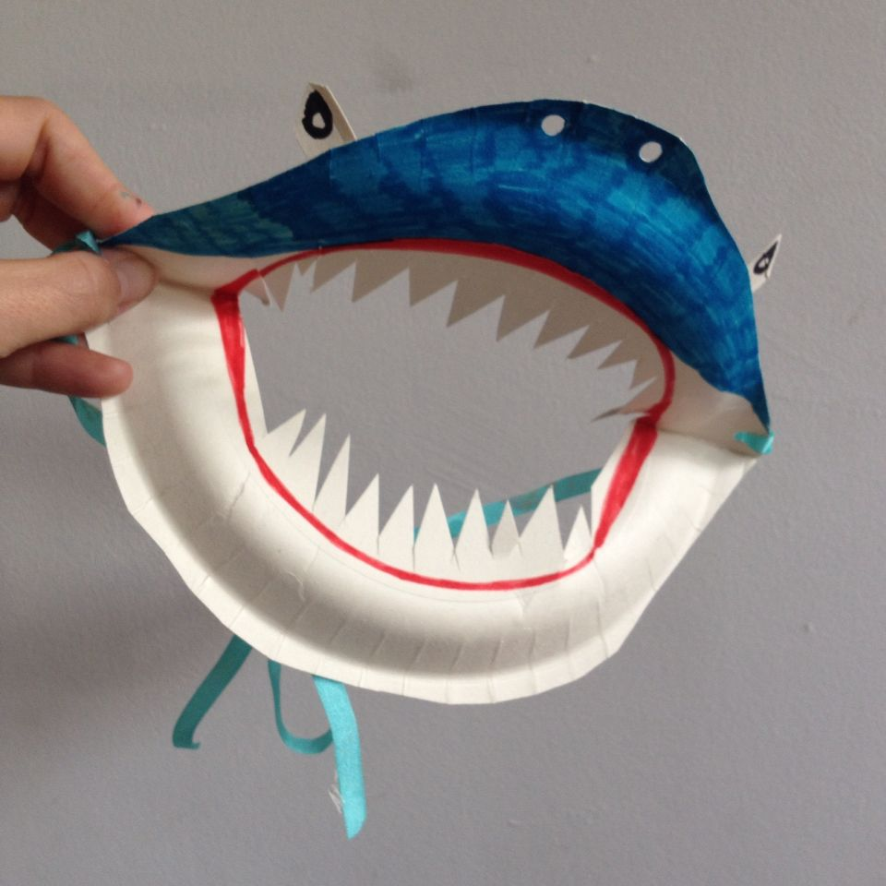
July 2021
Preschool Summer Camp
at Chesterbrook Academy
Add your school logo
Monday | Tuesday | Wednesday | Thursday | Friday
28 | 29 | 30 | 1 In Home Event: Gym Sport All ages | 2 Activity: Classroom Robot or Robot Vest
5 Students be encouraged to dress up in their favorite team jersey Activity: Nature Olympic Rings | 6 Activity: Pass the Torch Relay. | 7 Splash & Play Water Play 9:30-10:00 Toddlers 10:00-10:30 Beginners 10:30-11 Intermediates 11:00-11:30 Pre-k/School Agers Activity: Golf Ball Painting | 8 In Home Event: Soccer Shots Beginners Intermediates Pre-K | 9 Activity: Straw Javelin Throw
12 In Home Event: Burns and Company Puppet Show for all ages | 13 Activity: Animal Marionettes | 14 Splash & Play Water Play 9:30-10:00 Toddlers 10:00-10:30 Beginners 10:30-11 Intermediates 11:00-11:30 Pre-k/School Agers | 15 Activity: Please, Please, The Bees | 16 Activity: Marvelous Me Puppet
19 In Home Event: Chocolate Bar in A Car Beginners- 10:00 Intermediates -10:30 Pre-K-11:00 | 20 Activity: Silly Animal Toast (will be served for breakfast) | 21 Splash & Play Water Play 9:30-10:00 Toddlers 10:00-10:30 Beginners 10:30-11 Intermediates 11:00-11:30 Pre-k/School Agers Activity: Spice It Up | 22 Activity: Design a food truck. | 23 Activity: Hot and Cold food sorting using pictures from magazines/grocery store ads.
26 River Painting | 27 Activity: DewDrop Circles | 28 Splash & Play Water Play 9:30-10:00 Toddlers 10:00-10:30 Beginners 10:30-11 Intermediates 11:00-11:30 Pre-k/School Agers | 29 In Home Event: Dance on The Go Activity: What dissolves in Water? | 30 Activity: Shark Teeth
Activity Blocks
Address | Phone Number | School Level Website | Camp Director Email
Calendar is subject to change.

